Slide 1
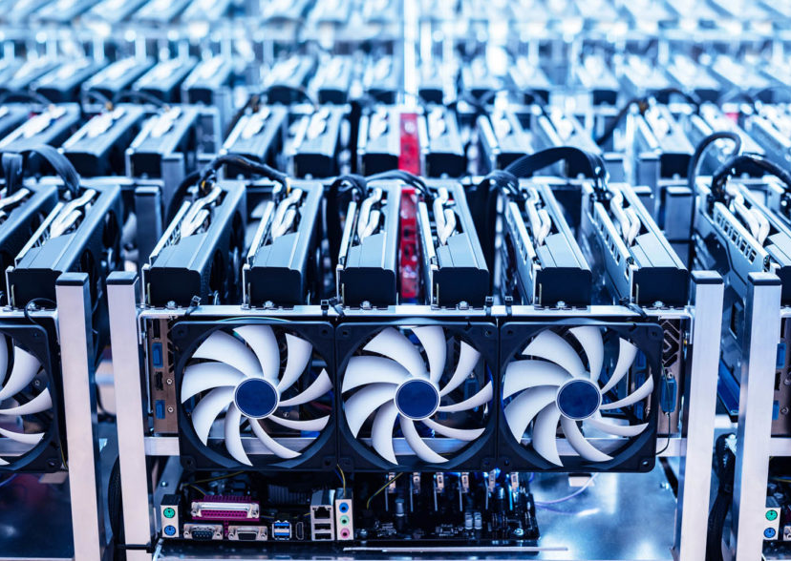
DeFi, Smart Contracts & Beyond
Aviv Zohar
The Hebrew University

Slide 2
Agenda for the talk
Transactions Fees in cryptocurrencies + Ethereum’s Gas mechanism
Smart contracts – Eliminating 3rd Party risk
DeFi (DEXes, Collateralized lending)
Flash Loans and how they are used to attack
Frontrunning and MEV
Pricing computation – DoS attacks on Ethereum.
L2s : Payment channel networks

Slide 3



Transaction Fees
We need to propagate + process a block before we create the next one $→$ Block size constraint
Demand for transactions may exceed available space
Hash
A mechanism is needed to allocate block space

Slide 4
Bitcoin’s mechanism
A pay-your-bid auction
Each transactions includes a fee that will be paid to miner upon inclusion in the blockchain.
Problem:
Users shade their bids, need to retransmit transactions with more bids, and may sometimes miss the block.

Slide 5
Strawman mechanism
Suppose the block has k slots for transactions
Use k’th price auction – charge everyone in the block the k’th price.
100
50
50
20
10

Slide 6
Strawman mechanism
Suppose the block has k slots for transactions
Use k’th price auction – charge everyone in the block the k’th price.
100
50
50
20
10
Problem: Miner will add additional transactions with higher k’th price.

Slide 7
Strawman mechanism
Suppose the block has k slots for transactions
Use k’th price auction – charge everyone in the block the k’th price.
100
50
50
50
20
10
Problem: Miner will add additional transactions with higher k’th price.

Slide 8
Challenges in designing a mechanism
Incentive compatibility for bidders
The miner is also strategic!
Add “fake bids”, ignore bids.
Side payments are possible
Multiple rounds: Transactions persist for more than one round.
Users may have deadlines and time-related preferences

Slide 9
[Lavi, Sattath, Zohar]
“monopolist auction” mechanism: All transactions get charged the price of lowest tx included in the block.
Easy to see: incentive compatible for myopic miners.
What about bidders?
Main result: “average gain from strategic bid shading diminishes as the number of bids increases”
34
50
50
100
20
10

Slide 10
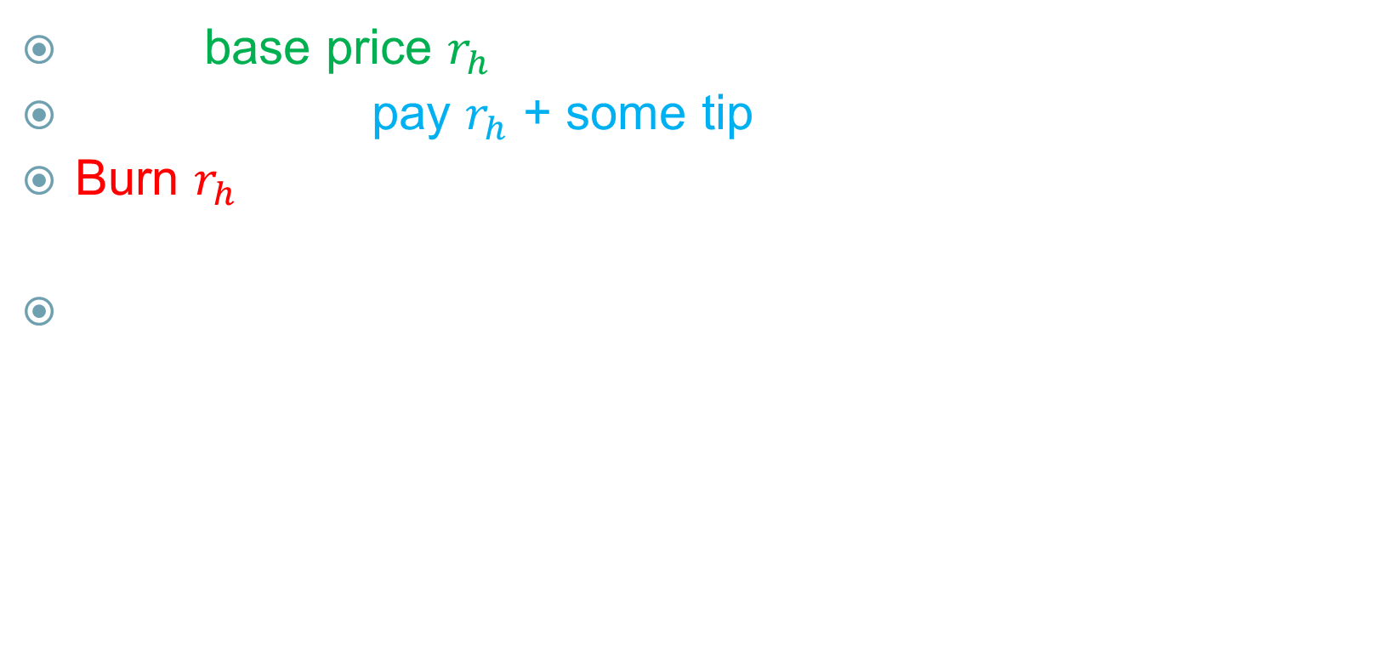
EIP 1559
Set a base price $r_{h}$ (which depends on past blocks only)
Transactions pay $r_{h}$ + some tip (optional)
Burn $r_{h}$. Tip goes to the miners.
Adjust base price if based on “demand”
$s^{∗}=$ target block size $s_{h−1}=$ size of prev block
$$r_{h}=r_{h−1}\left(1+\frac{1}{8}\frac{s_{h−1}−s^{∗}}{s^{∗}}\right)$$

Slide 11
EIP 1559
[Roughgarden] analyzes the mechanism. It is
“Typically” User Incentive Compatible (UIC) (except at very low base fee)
Incentive compatible for myopic miners (MMIC)
OCA-proof
The main issue: At longer time scales, miners can push the base fee to 0 and revert to monopolist pricing.

Slide 12
Impossibilities: [Chung & Shi], [Yaish, Gafni], [Chung, Roughgarden Shi]
Bottom line: No mechanisms that are incentive compatible for (myopic) miners, users, and resist collusion (when there is contention between transactions
Work on the temporal aspects: [Nisan] [Yaish, Gafni]

Slide 13
Smart Contracts

Slide 14

Before: sequence transactions to send money
Now: sequence execution of code on some imaginary computer
The entire Ethereum network is simulating one very weak computer
Alice sends 3 BTC to Bob
Bob sends 1 BTC to Charlie
Dave sends 1 BTC to Eve
adjust_price(2,7)
add_player(alice,7,6)
Bid(7,0xa1d45)
The single computer
Replicated state machine
Input
Input
Input
Input

Slide 15
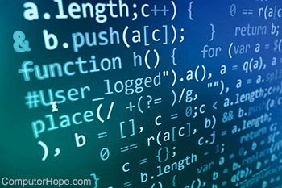

Code for smart contracts
Not smart
Not a contract
A computer program with
Code
State
endPoint= 3
Y[1] = 2
Y[2] = 7
owner = 0x1a6
Balance

Slide 16
Smart contracts
A transaction on Ethereum
Sends money to a smart contract
Runs code of the smart contract (on some input) and thus changes its state.
Guarantees:
Calls are atomic: All or nothing. (execution completes entirely or aborts and “rolls-back” all changes)
The run is deterministic (no probabilistic action)
Everything is “public” and visible to anyone who follows the blockchain
The code may send money from its own account to other accounts

Slide 17
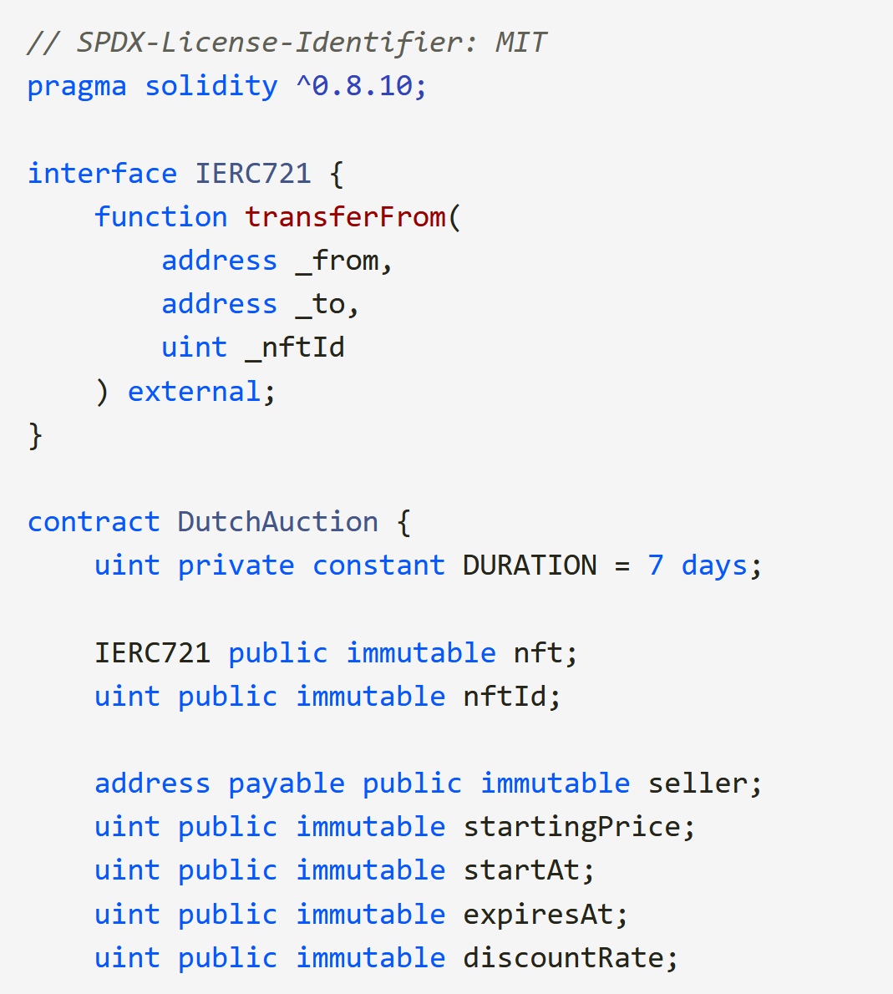
Dutch auction
Example
Persistent variables (State)

Slide 18
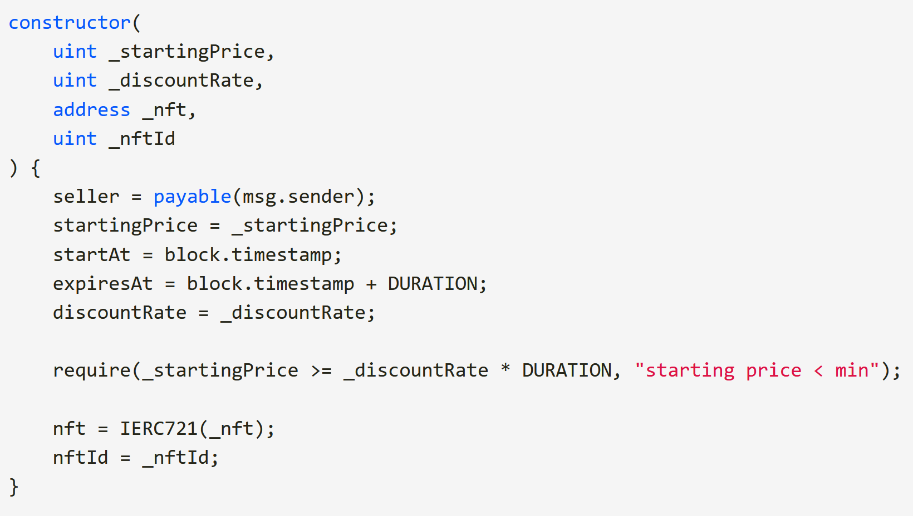
Example
Initialization Code

Slide 19
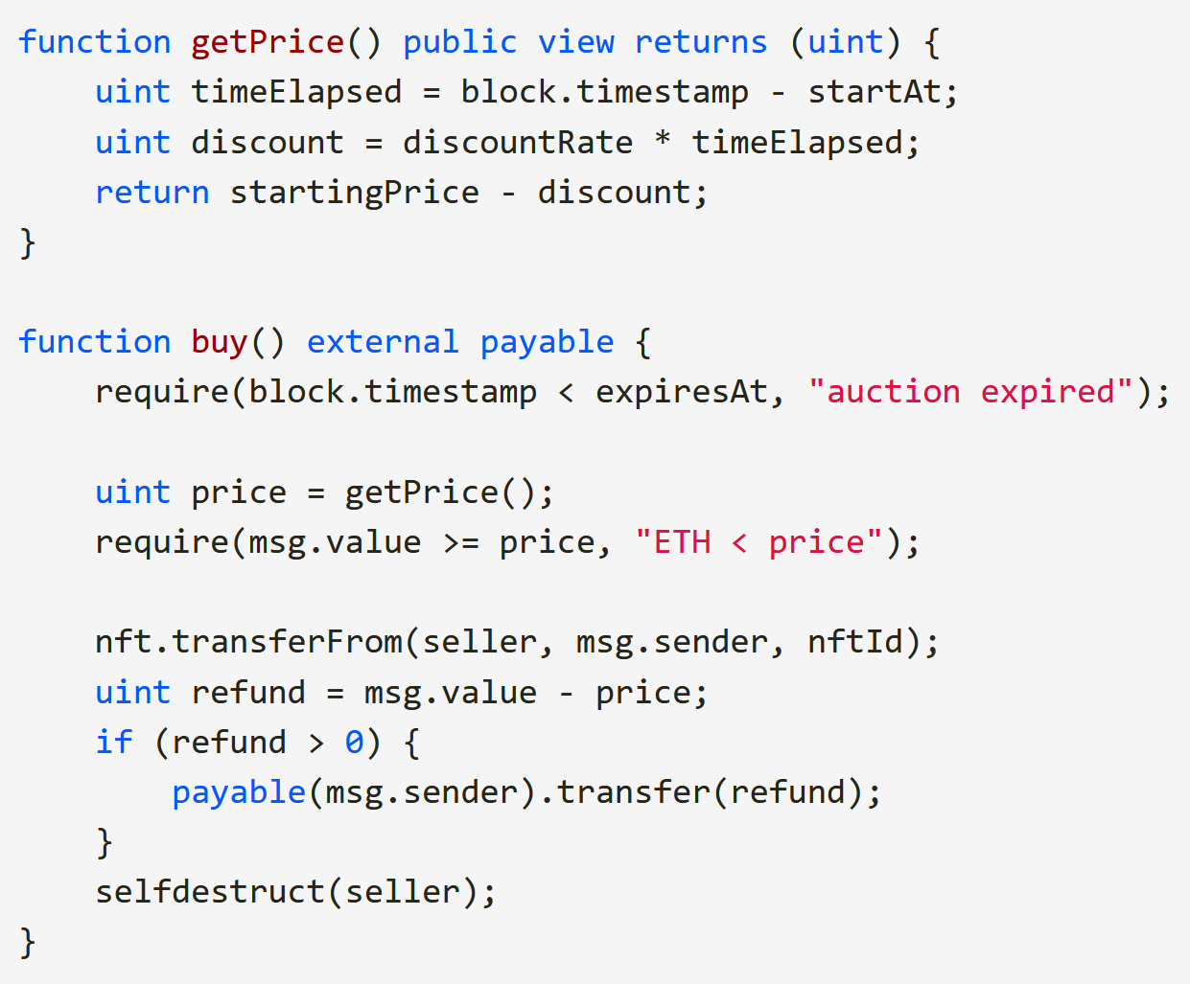
Example
Sending funds

Slide 20
Why Smart Contracts?
A human auctioneer may cheat or run away with our auctioned item.
Smart contracts eliminate 3rd party risk.
A smart contract will do exactly what’s in its code

Slide 21
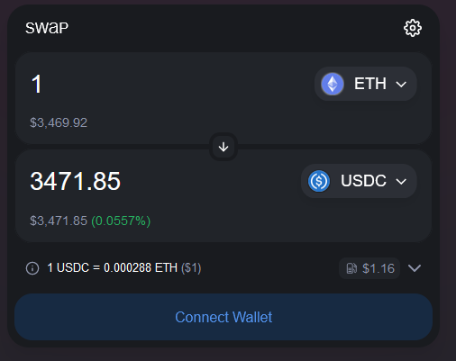
DEXES & Automated Market Makers (AMMs)
A smart contract that allows you to swap one type of token for another

Slide 22
The Oracle problem
Smart contracts can easily read blockchain data
But no access to external data.
For example, the current exchange rate of USD-Eth is unknown.
A price oracle is constructed typically using one of two approaches:
Rely on external injection of price data
(needs to be timely and trusted data)
Via a market maker mechanism

Slide 23
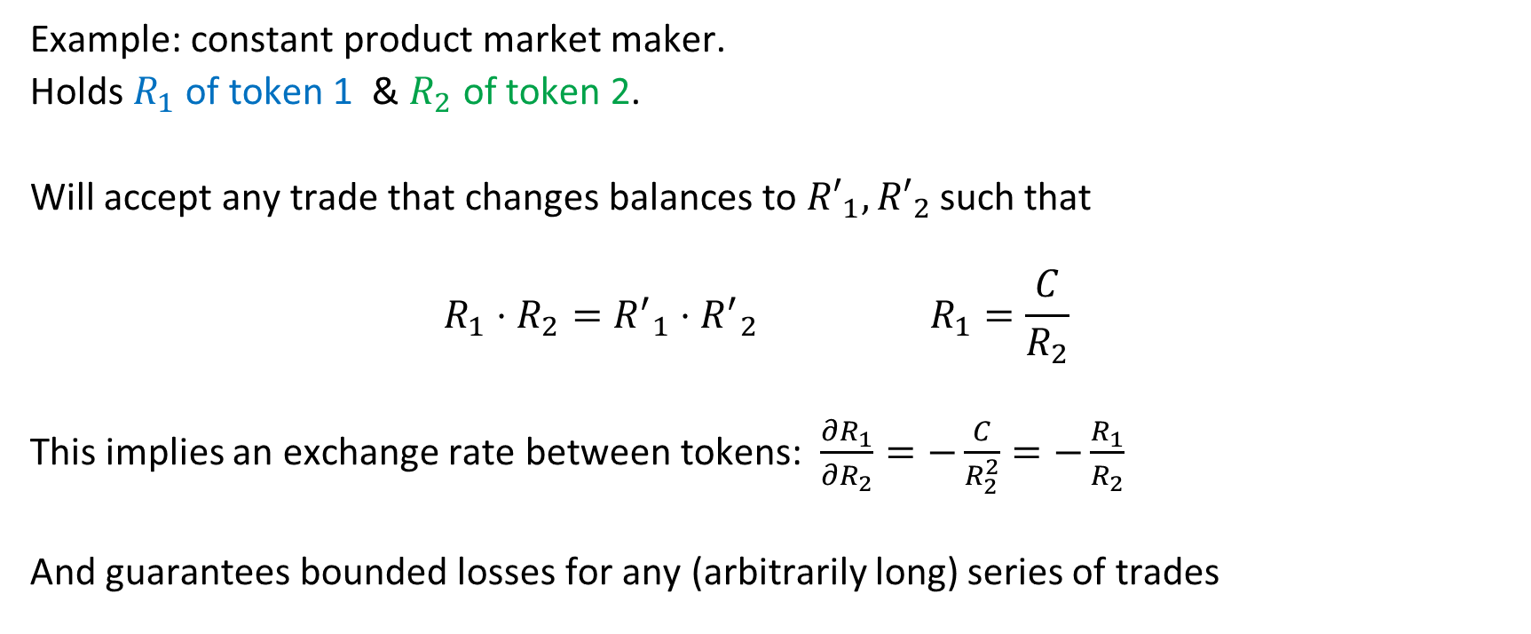
Automated Market Makers (AMMs)
Example: constant product market maker.
Holds $R_{1}$ of token 1 & $R_{2}$ of token 2.
Will accept any trade that changes balances to ${R′}_{1},{R′}_{2}$such that
$$R_{1}⋅R_{2}={R^{′}}_{1}⋅{R^{′}}_{2} R_{1}=\frac{C}{R_{2}}$$
This implies an exchange rate between tokens: $\frac{∂R_{1}}{∂R_{2}}=−\frac{C}{R_{2}^{2}}=−\frac{R_{1}}{R_{2}}$
And guarantees bounded losses for any (arbitrarily long) series of trades

Slide 24


Arbitrage opportunities
Eth
USDC
Eth
USDC
Eth
USDC
Alice
Bob

Slide 25
Arbitrage opportunities
Eth
USDC
Eth
USDC
Eth
USDC
Alice
Bob

Slide 26
Arbitrage opportunities
Eth
USDC
Eth
USDC
Eth
USDC
Alice
Bob

Slide 27
Arbitrage opportunities
USDC
USDC
Eth
USDC
USDC
USDC
USDC
USDC
USDC
USDC
Alice
Bob

Slide 28
Collateralized loan platforms
Will let you borrow an amount of some token.
Must provide collateral that is worth more than the token you borrow.
Example: Borrow 800$ deposit 1000$ of Eth as collateral.
Borrowers pay some interest rate.
The position of the lender is liquidated if the collateral ever comes within some margin of the loan.

Slide 29

Why use collateralized loans?
Alice holds Eth (because she thinks its value will rise)
She also thinks USD’s value will go down
AAVE
Eth
USDC
Alice

Slide 30
Why use collateralized loans?
Alice holds Eth (because she thinks its value will rise)
She also thinks USD’s value will go down
AAVE
Eth
USDC
Alice

Slide 31
Why use collateralized loans?
Alice holds Eth (because she thinks its value will rise)
She also thinks USD’s value will go down
AAVE
Debt: 3$
Eth
USDC
Alice

Slide 32
Why use collateralized loans?
AAVE
Debt: 3$
If she’s right, she can buy back the USD for less Eth
Eth
USDC
Alice

Slide 33
Why use collateralized loans?
AAVE
Debt: 3$
If she’s right, she can buy back the USD for less Eth
Eth
USDC
Alice

Slide 34
Why use collateralized loans?
AAVE
And use it to redeam the collateral
Eth
USDC
Alice

Slide 35
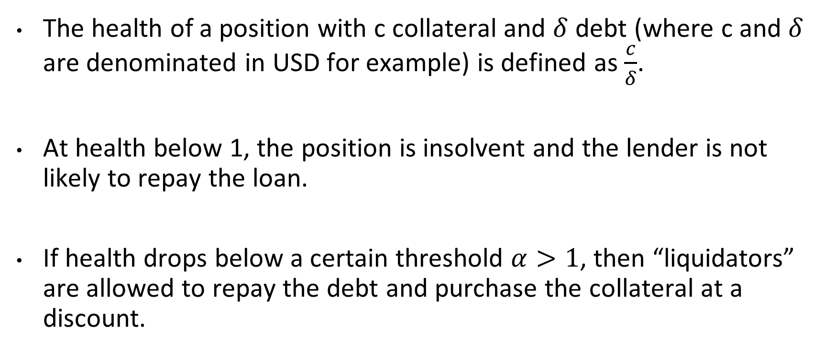
Liquidations
The health of a position with c collateral and $δ$ debt (where c and $δ$ are denominated in USD for example) is defined as $\frac{c}{δ}$.
At health below 1, the position is insolvent and the lender is not likely to repay the loan.
If health drops below a certain threshold $α>1$, then “liquidators” are allowed to repay the debt and purchase the collateral at a discount.

Slide 36
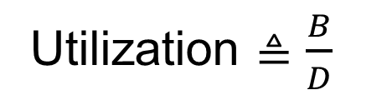
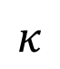
Interest rate on loans and deposits
Lending platforms (such as AAVE & Compound) typically set interest rates based on the availability for funds for lending.
Total Deposited liquidity: D, total burrowed funds B.
Annual Interest
Utilization $≜\frac{B}{D}$
$$κ$$
1
utilization

Slide 37
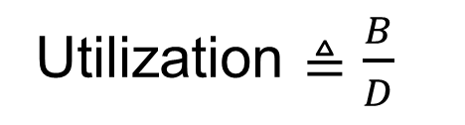
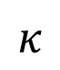
Interest rate on loans and deposits
As utilization approaches 1, it becomes more profitable to lend to the pool and more costly to borrow
Interest rate on loans
Annual Interest
Interest for deposits
Utilization $≜\frac{B}{D}$
$$κ$$
1
utilization

Slide 38
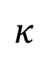
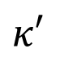
Some critique
Suppose we knew the true interest rate is roughly at 5%
Let us compare two curves.
Which one is more profitable? What did we trade-off here?
Annual Interest
Utilization $≜\frac{B}{D}$
5%
$$κ$$
$$κ′$$
1
utilization

Slide 39
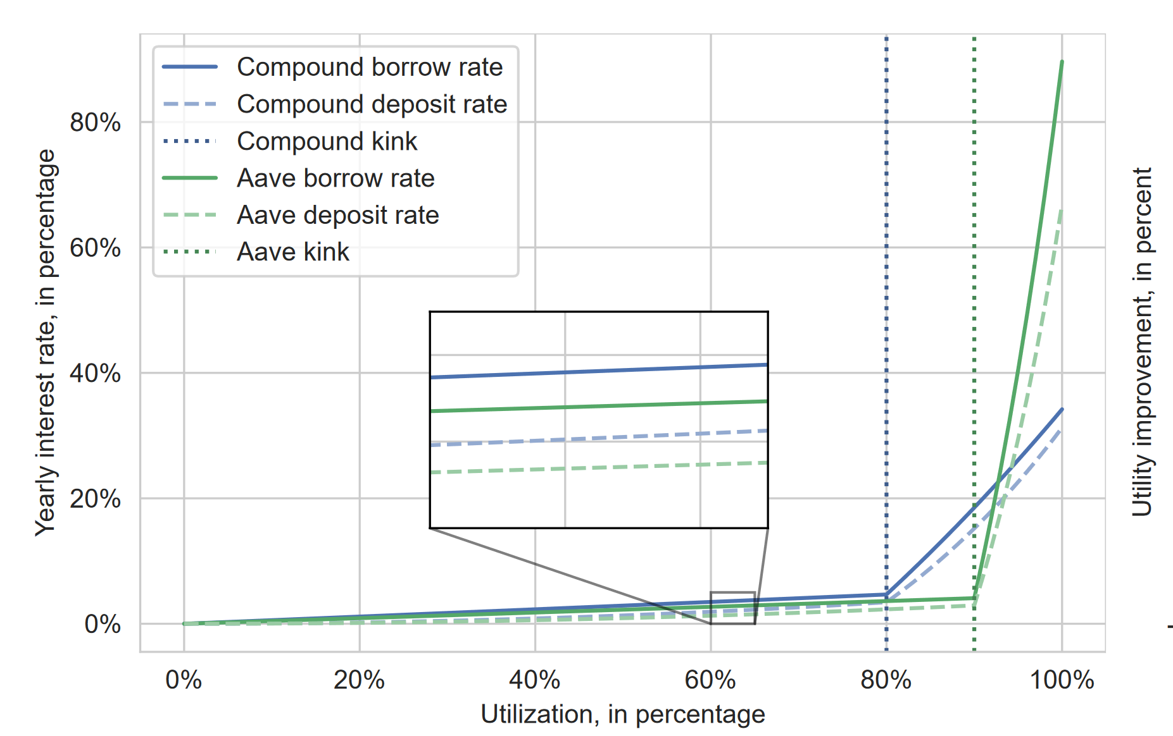
Yaish A, Dotan M, Qin K, Zohar A, Gervais A. Suboptimality in DeFi.

Slide 40
Some more critique
Yaish A, Dotan M, Qin K, Zohar A, Gervais A. Suboptimality in DeFi.
Slippage implies that large depositors can (in the short run) gain money by withdrawing funds from the pool.
Friction (transaction fees) keep others from re-balancing quickly
Annual Interest
Utilization $≜\frac{B}{D}$
$$κ′$$
1
utilization

Slide 41
Flash loans

Slide 42
The need for liquidity
Oftentimes you need temporary liquidity to be able to execute a trade
Examples:
An arbitrage opportunity
Moving collateral between lenders
Participating in liquidation at a discounted price
Eth
USDC
Eth
USDC
Eth
USDC
AAVE
Compound

Slide 43
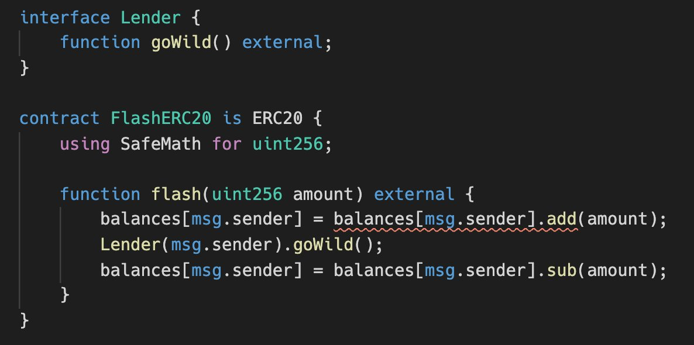
A Flash Loan – Risk free
Cheap, no risks, no collateral needed.
From https://www.coindesk.com/the-defi-flash-loan-attack-that-changed-everything

Slide 44
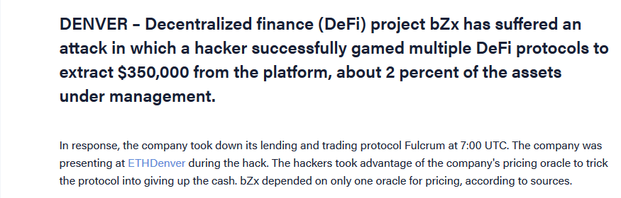
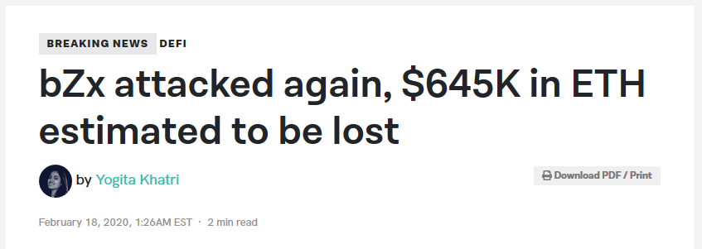
A few days later

Slide 45



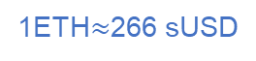
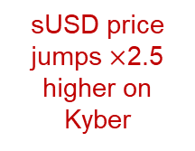
The 2nd attack – an oracle attack
Step 1:
The attacker borrows a large sum of ether in a flash loan
1ETH$≈$266 sUSD
7,500 Ether
Step 2:
Buy sUSD at market price.
Step 3:
Buy sUSD on Kyber
sUSD price jumps $×$2.5 higher on Kyber
943,837 sUSD
156,003 sUSD
(3,082 Eth remaining)
1ETH=111 sUSD
Step 4:
Using sUSD as collateral, Borrow Ether
Price data
6796 ETH (+ 3,082 Eth from before)
Usually, his sUSD collateral would only allow a smaller loan
Step 5:
Repay the flash loan
2,378 Eth left over
as profit.

Slide 46
Frontrunning and MEV

Slide 47

Tokens
NFTs
Other high level objects
Smart Contracts
Native currency
Sequenced Data
rewards
Sequencing
Consensus
Networking
Layers and how they are broken

Slide 48
Buy 100 Eth with USDT
Alice

Slide 49
Buy 100 Eth with USDT
Alice

Slide 50
Bob
Buy 100 Eth with USDT
Alice

Slide 51
Bob
Buy 20 Eth
Buy 100 Eth with USDT
Sell 20 Eth
“Sandwich Attack”
Alice
Dave

Slide 52
Bob
Buy 20 Eth
Buy 20 Eth
Buy 100 Eth with USDT
Sell 20 Eth
Sell 20 Eth
Alice
Dave

Slide 53
Bob
Buy 20 Eth Price=P`
Buy 20 Eth Price=P
Buy 100 Eth with USDT
Sell 20 Eth
Sell 20 Eth
Alice
Dave

Slide 54
Bob
Buy 20 Eth Price=P`
Buy 20 Eth Price=P
Sell 20 Eth
Sell 20 Eth
Buy 100 Eth with USDT
Alice
Dave

Slide 55
Searchers exploit arbitrage and frontrunning opportunities
A large fraction of all transactions failed or did not operate as expected, pushing out regular transactions and increasing fees.
New players entered the market
Builders who bundle together transactions into blocks and auction these to miners
Relays who keep your transaction bundles and blocks secret and give them to miners
User
Builder
Relay
Validator / Proposer
Searcher

Slide 56
Speculative Execution DoS Attacks
Yaish, Aviv, Kaihua Qin, Liyi Zhou, Aviv Zohar, and Arthur Gervais. "Speculative denial-of-service attacks in ethereum."

Slide 57



Transactions consume resources
Transactions (by potentially anonymous users) consume limited resources
Communication
Computation to verify
Space in mempools (potentially evicting other transactions)
Resource exhaustion: an attack vector. E.g., [“Broken Metre” Perez & Livshits]

Slide 58
Speculative execution
A transaction appears. Currently not enough fees to make it into the next block.
Should a miner run it?
Fees are only paid if the transaction makes it into a block.
Problems:
Might have to re-run. Execution is context dependent.
It may get evicted from the mempool.
Currently miners add transactions to mempool without running them.

Slide 59

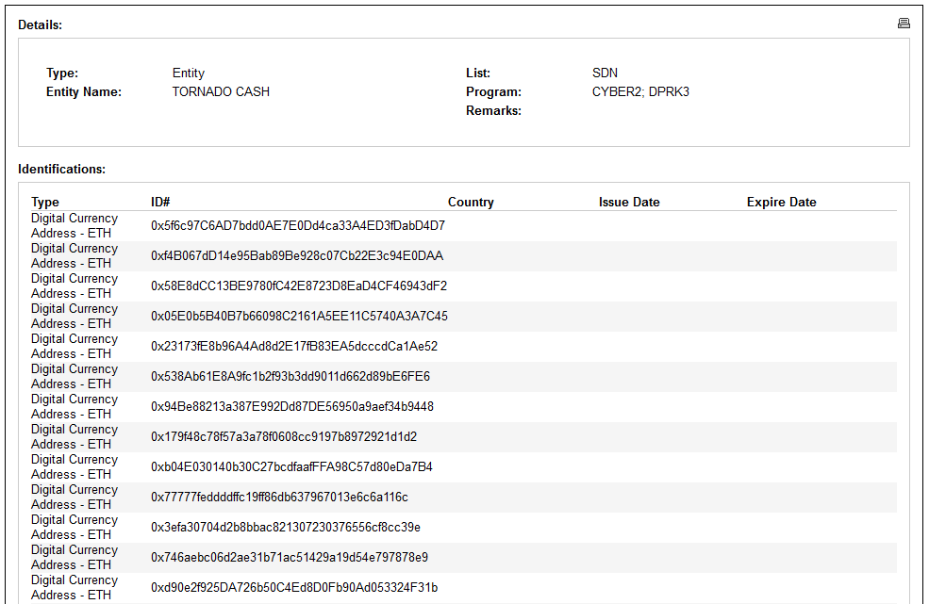
OFAC SDN list
A large fraction of nodes censor such transactions
Most importantly: this censorship is external to consensus rules

Slide 60

Attack I: ConditionalExhaust
Does proposer censor?
No
Exit (waste no more gas)
23,628 gas units
Up to gas limit $(3⋅{10}^{7}$ gas)
Yes
Run EXPENSIVE computation
Send 1 wei to sanctioned address
Tx discarded no fees paid

Slide 61
ConditionalExhaust Attack
Does proposer censor?
No
Exit (waste no more gas)
Yes
Serve transaction during a censoring proposer’s slot
Even if later included in block: Paid ~1270x less gas than “consumed”
Flashbots “private transaction”:
Served directly to the proposer, bypassing the public mempool & restrict to a specific block
Run EXPENSIVE compute
Send 1 wei to sanctioned address

Slide 62
Evaluation
Min Required hardware (Flashbots): a 4 core CPU operating at 2.8GHz, 16GB of RAM, and an SSD with at least 2TB of free space.
Our testbed’s hardware: AMD Ryzen Threadripper 3990X CPU with 64 cores operating at 2.9GHz, 256GB of RAM, and NVMe SSDs
140 ConditionalExhaust txs with high fees DoS our node (It creates empty blocks)
Txs are not discarded from mempool after being discovered as censored.
Even if they were, we could retransmit the same tx!

Slide 63
ConditionalExhaust can be changed to hit anyone that runs the transaction even before the proposer
Reputation mechanisms are in place to try to avoid that.
These can be attacked to ruin the reputation of players…
User
Builder
Relay
Validator / Proposer
Searcher

Slide 64
Payment Channel Networks

Slide 65






Bi-directional Channels
Redeemable if signed by both Alice & Bob
Joint Account
2 BTC

Slide 66

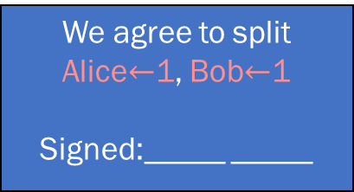

Bi-directional Channels
Redeemable if signed by both Alice & Bob
Account
2 BTC
We agree to split Alice$←$1, Bob$←$1
Signed:_____ _____

Slide 67

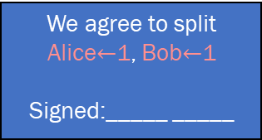

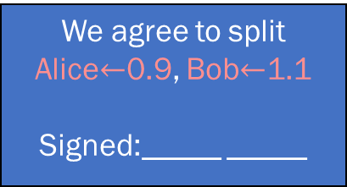

Bi-directional Channels
Redeemable if signed by both Alice & Bob
Account
2 BTC
But what if Alice uses the old state’s transaction?
We agree to split Alice$←$1, Bob$←$1
Signed:_____ _____
We agree to split Alice$←$1, Bob$←$1
Signed:_____ _____
We agree to split Alice$←$0.9, Bob$←$1.1
Signed:_____ _____

Slide 68

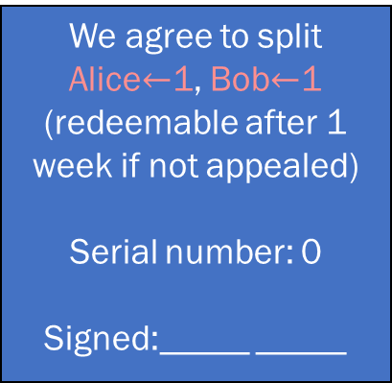
Bi-directional Channels
Redeemable if signed by both Alice & Bob
Account
2 BTC
We agree to split Alice$←$1, Bob$←$1
(redeemable after 1 week if not appealed)
Serial number: 0
Signed:_____ _____

Slide 69


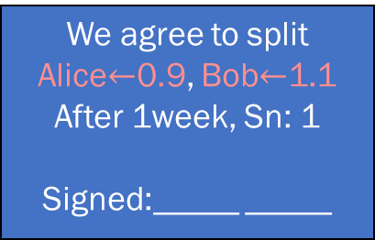
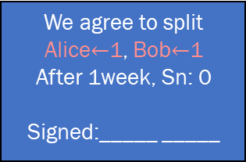
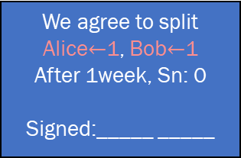
Bi-directional Channels
Redeemable if signed by both Alice & Bob
Account
2 BTC
We agree to split Alice$←$1, Bob$←$1
After 1week, Sn: 0
Signed:_____ _____
We agree to split Alice$←$1, Bob$←$1
After 1week, Sn: 0
Signed:_____ _____
We agree to split Alice$←$0.9, Bob$←$1.1
After 1week, Sn: 1
Signed:_____ _____

Slide 70
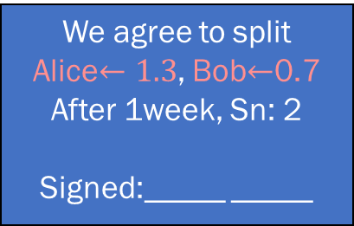




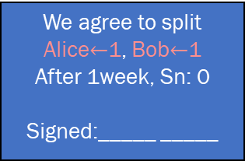
Bi-directional Channels
Redeemable if signed by both Alice & Bob
Account
2 BTC
We agree to split Alice$←$1, Bob$←$1
After 1week, Sn: 0
Signed:_____ _____
We agree to split Alice$←$0.9, Bob$←$1.1
After 1week, Sn: 1
Signed:_____ _____
We agree to split Alice$←1.3$, Bob$←$0.7
After 1week, Sn: 2
Signed:_____ _____

Slide 71
Properties of Two-Way Channels
Trustless: Alice & Bob can always claim their money
(even if the other isn’t cooperative)
Many small transfers Only 2 blockchain transactions
Fast Payments
Low fees
Micropayments are possible

Slide 72

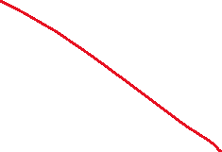

Limitations
Funds are locked in the channel
Payments are only between Alice & Bob.
Liquidity constrains the use of channels
Participants need to be online to monitor & appeal.

Slide 73


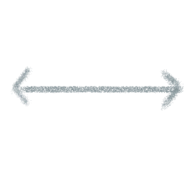

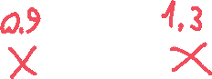


From channels to networks
A trustless system. So who goes first?

Slide 74
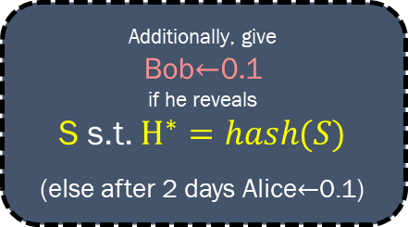
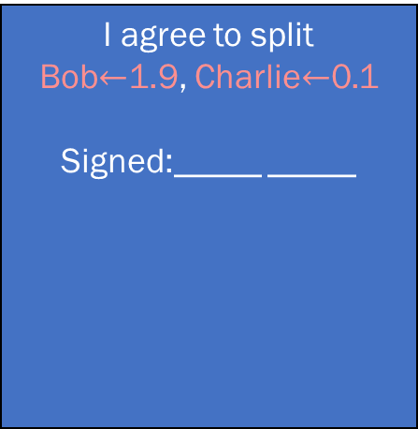



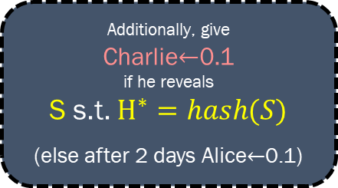


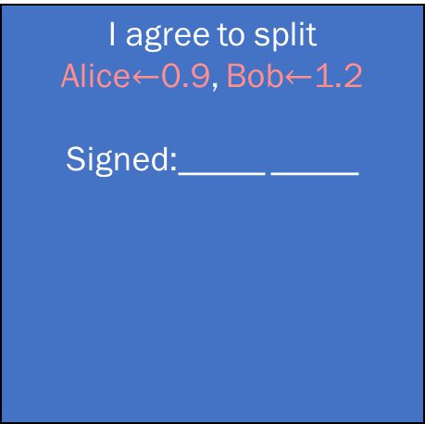


From channels to networks
I agree to split Alice$←$0.9, Bob$←$1.2
Signed:_____ _____
I agree to split Bob$←$1.9, Charlie$←$0.1
Signed:_____ _____
Additionally, give
Bob$←$0.1 if he reveals
S s.t. $H^{∗}=hash(S)$
(else after 2 days Alice$←$0.1)
Additionally, give
Charlie$←$0.1 if he reveals
S s.t. $H^{∗}=hash(S)$
(else after 2 days Alice$←$0.1)
HTLCs
Hashed Timelocked Contracts

Slide 75

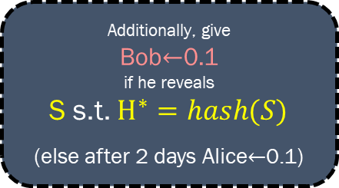









If Charlie & Alice Try to Cheat Bob
I agree to split Alice$←$0.9, Bob$←$1.2
Signed:_____ _____
I agree to split Bob$←$1.9, Charlie$←$0.1
Signed:_____ _____
Additionally, give
Bob$←$0.1 if he reveals
S s.t. $H^{∗}=hash(S)$
(else after 2 days Alice$←$0.1)
Additionally, give
Charlie$←$0.1 if he reveals
S s.t. $H^{∗}=hash(S)$
(else after 2 days Alice$←$0.1)

Slide 76









If Charlie Stalls
I agree to split Alice$←$0.9, Bob$←$1.2
Signed:_____ _____
I agree to split Bob$←$1.9, Charlie$←$0.1
Signed:_____ _____
Additionally, give
Bob$←$0.1 if he reveals
S s.t. $H^{∗}=hash(S)$
(else after 2 days Alice$←$0.1)
Additionally, give
Charlie$←$0.1 if he reveals
S s.t. $H^{∗}=hash(S)$
(else after 2 days Alice$←$0.1)

Slide 77
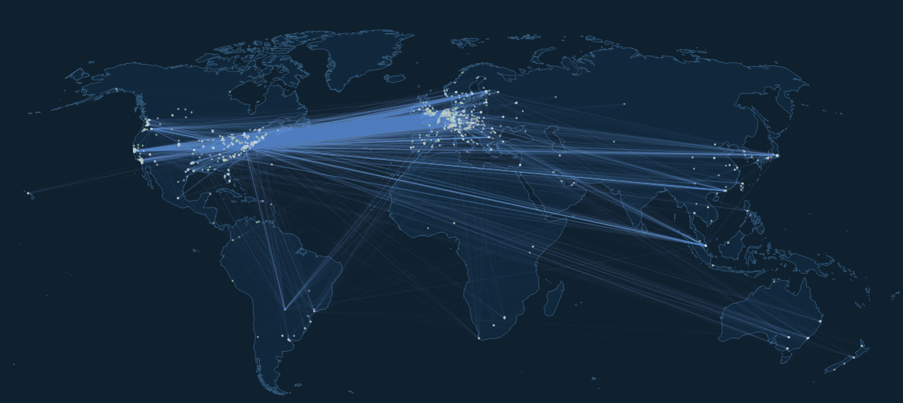
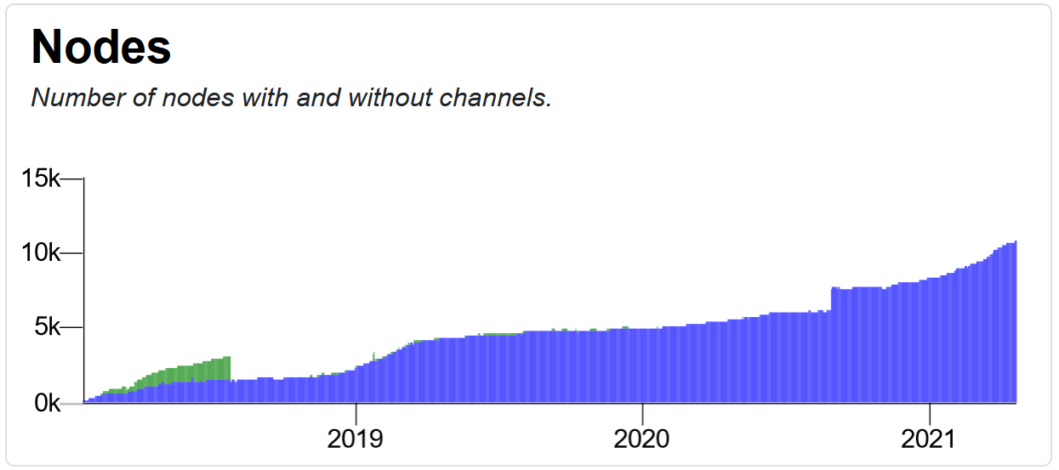
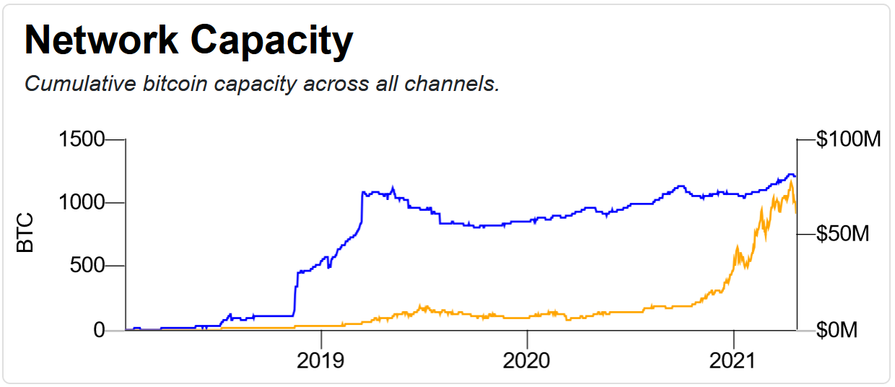
Sources:
https://explorer.acinq.co/
https://bitcoinvisuals.com/

Slide 78

Congestion Attacks
With Ayelet Mizrahi

Slide 79
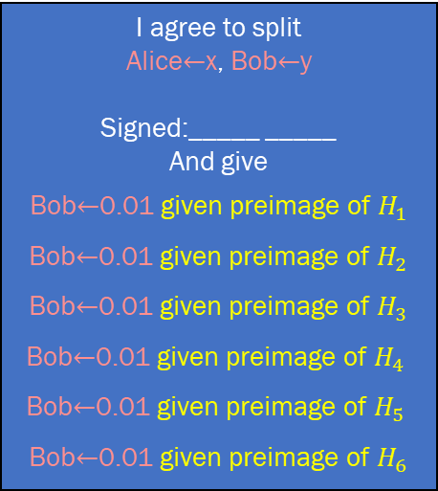




Congestion Attacks With Ayelet Mizrahi
I agree to split Alice$←$x, Bob$←$y
Signed:_____ _____
And give
Bob$←$0.01 given preimage of $H_{1}$
Bob$←$0.01 given preimage of $H_{2}$
Bob$←$0.01 given preimage of $H_{3}$
Bob$←$0.01 given preimage of $H_{4}$
Bob$←$0.01 given preimage of $H_{5}$
Bob$←$0.01 given preimage of $H_{6}$
If several payments are routed through the channel, transaction sizes increase
If secrets are propagated back, transactions are replaced with smaller ones
But what if the secret isn’t propagated?

Slide 80
Congestion Attacks With Ayelet Mizrahi
I agree to split Alice$←$x, Bob$←$y
Signed:_____ _____
And give
Bob$←$0.01 given preimage of $H_{1}$
Bob$←$0.01 given preimage of $H_{2}$
Bob$←$0.01 given preimage of $H_{3}$
Bob$←$0.01 given preimage of $H_{4}$
Bob$←$0.01 given preimage of $H_{5}$
Bob$←$0.01 given preimage of $H_{6}$
Pending HTLCs remain until expiration (up to 2 weeks!)
After 483 transfers are open, the channel is effectively blocked

Slide 81




Congestion Attacks With Ayelet Mizrahi
The Attack
Connect to the network
Open many transfers through a long path (up to 20 hops)
End node does not propagate the secret
Channel is now blocked for hours/days

Slide 82
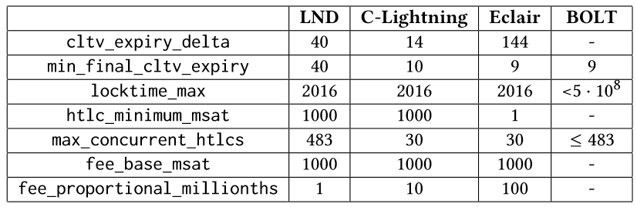
Default values
Most nodes

Slide 83
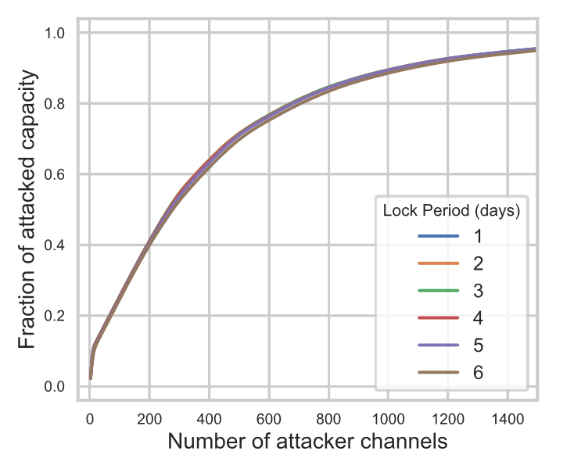

Slide 84
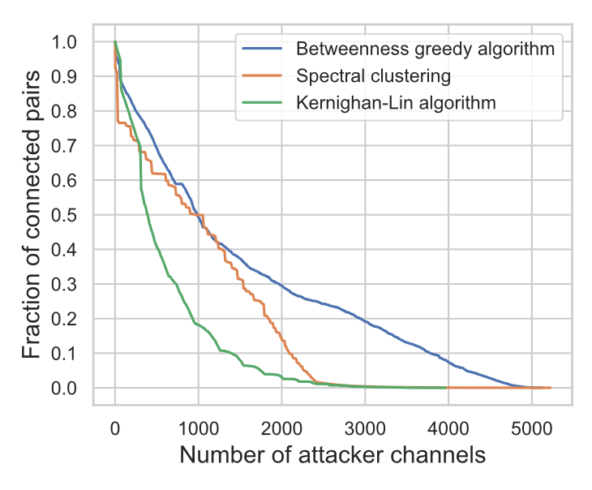

Slide 85
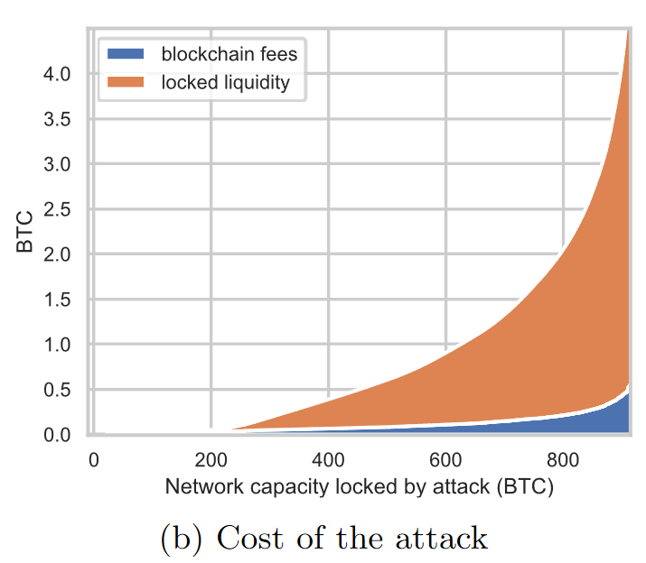

Slide 86
Mitigations
(In the paper we also explore attacks on single nodes to isolate them)
Enforce fast HTLC resolution
Reduce max route length
Setting the number of max concurrent payments based on trust level
Loop Avoidance

Slide 87
Flood & Loot
With Jona Harris

Slide 88
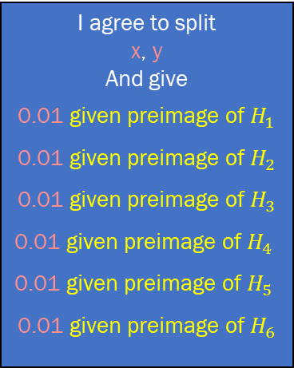
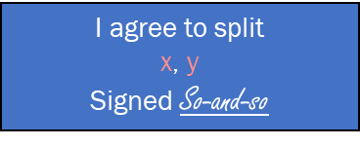




The Flood & Loot Attack With Jona Harris
Idea:
Force victim nodes to transact on-chain to claim funds
Make transactions too large for all victims to succeed

Slide 89
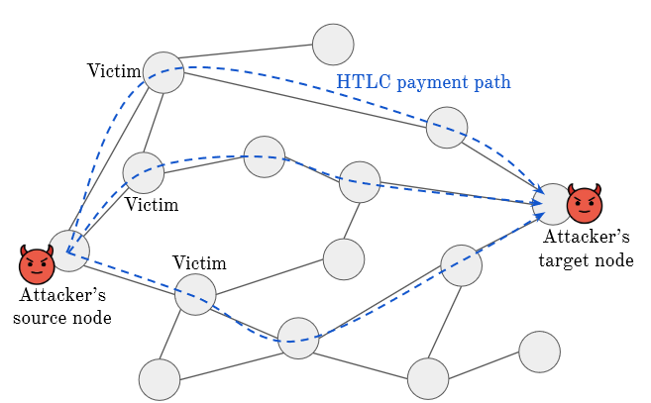


Slide 90


Slide 91



Slide 92


Slide 93
What to do?
Endpoints (Exchanges etc) should consider payments as accepted only if the HTLC was removed from the channel.
Reduce network wide max-HTLC?
Non-replaceable HTLC transactions
Auto-extend deadlines for appeals if congested

Slide 94







A privacy problem
“Binary search” to learn exact liquidity
Free & anonymous queries
Execute for many channels to learn when payments are sent and to whom

Slide 95

Economic Questions
How much would nodes charge as fees?
How would the network be built?
How to allocate liquidity?
(Joint work with Simina Brânzei, Erel Segal-Halevi, Yotam Sali)

Slide 96

Recap
A cool layer 2 system
Many issues left to resolve
My opinion: Not ready (yet!) to bear the full burden of scaling Bitcoin

